Slide 1
Sentiment Analysis on Hindi Movie Reviews

Slide 2
Why Dataset in Hindi?
Little work has been done in Sentiment Analysis for Indian Languages.
Web content in Hindi is booming .
Sentiment Analysis of movie reviews could help in better rating of movies.

Slide 3
Challenges of sentiment analysis for Hindi
Hindi is morphologically rich and a free order language as compared to English language.
Hindi is a resource scarce language which causes problems in collection and generation of datasets.
Limited resources are available for this language like Hindi SentiWordNet (H-SWN).

Slide 4
Methods implemented
Resource based classification using Hindi SentiWordNet(H-SWN).
Machine Translation- Based Semantic Analysis.
In-language classification through various classifiers like Deep Belief Network, Neural Network, SVM, Decision Tree etc.

Slide 5
Resource based Classification
It uses Hindi SentiWordNet (H-SWN).
Every word available in H-SWN has a corresponding positive and a negative sentiment score.
A vote is taken for each word in a review.
The polarity with majority is predicted as the sentiment of a review.

Slide 6
Algorithm for Resource Based Classification
Input:
A list of reviews, R which contain positive reviews and negative reviews in string format R = { p₁, p₂....p_{m1}, n₁, n₂....n_{m2}}where,
m₁ = number of positive reviews
m₂ = number of negative reviews
Hindi SentiWordNet dictionary dict which contain a tuple for every word having its positive polarity score and negative polarity score
Output:
A list P containing the polarity of reviews

Slide 7
1.Make a list of polarity of reviews P =[]
2.For each review r_{i} in R:
3. Apply preprocessing on r_{i}
4. Make a list of votes v=[]
5. Initialize two variables x1=0, x2=0
6. For each word w in r_{i} :
7. if w exists in dict
8. pos_score, neg_score = dict[w]
9. if pos_score > Neg_score
10. v.append(1)
11. x1+=pos_score
12. else
13. v.append(0)
14. x2+=neg_score
15. else
16. ignore the word
17. ENDFOR

Slide 8
18. x = number of ones in the list
19. y = number of zeros in list
20. if x > y
21. sense = 1 (here 1 denotes positive)
22. else if y > x
23. sense = 0 (here 0 denotes negative)
24. else if x1 > x2
25. sense = 1
26. else
27. sense = 0
28. P.append(sense)
29.ENDFOR

Slide 9
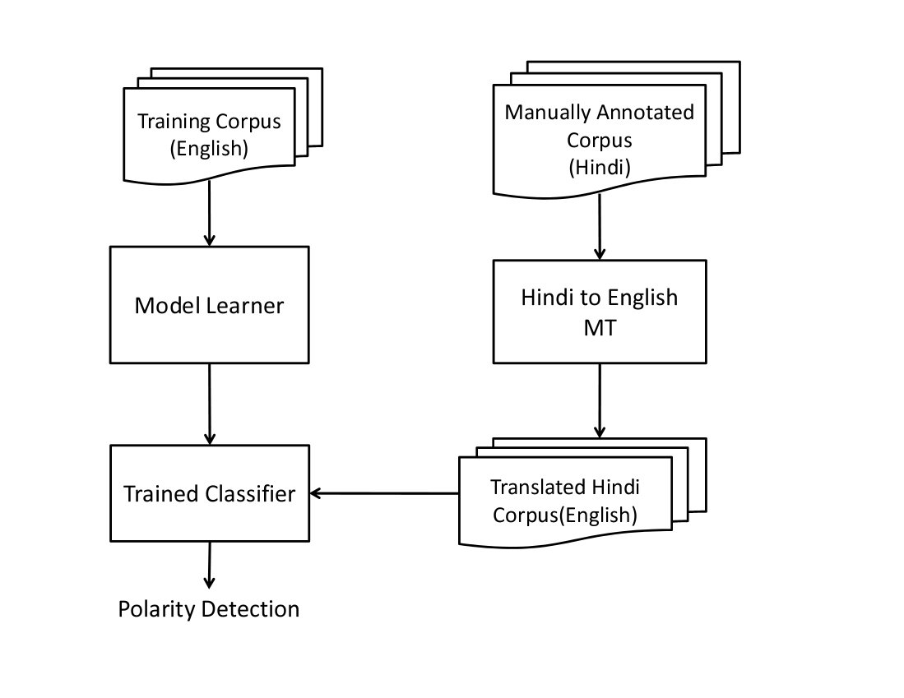
Machine Translation based Semantic Analysis

Slide 10
In-Language Classification
Feature extraction using 2 methods:
Unigram Model
TF-IDF Model

Slide 11
Unigram Model
A lexicon is created that contains all words in dataset except stop words and some highly frequent words that donot affect review sentiment.
Feature matrix of size m*n
where,
m= number of reviews in our dataset
n= number of words in the lexicon
For each element of the matrix, if that lexicon word occurs in the review, we add 1 to index of that word in lexicon set.

Slide 12
Algorithm for Computing Feature Matrix Using unigrams
Input: We have a list of reviews, R which contain positive reviews and negative reviews in string format. R = {p₁, p₂....p_{m1}, n₁, n₂....n_{m2}} where,
m₁= number of positive reviews
m₂= number of negative reviews
Output: A feature set F, which is list of features for each review.
F ={f₁, f₂...f_{m1}, f_{m1+1}...f_{m1+m2}}
size of feature set F : (m₁+m₂)*n
where,
n = the number of features in a single review that is equal to the length of lexicons set

Slide 13
1.Create a set of lexicons L.
2.For each review r_{i} in R:
3. tokenized_words = word_tokenize(r_{i})
4. words = preprocessing(tokenized_words)
L+=words
6.ENDFOR
7.For each review r_{i} in R:
8. F = list along with features and labels
9. features = list of zeros, size equal to length of lexicons set L
10. For each word w in r_{i}:
11. If w exist in L
12. index = L.index(w)
13. features[index] += 1
14. If r_{i} belongs to positive review
15. F.append([features,1])
16. Else
17. F.append([features,0])
18.ENDFOR
19.Shuffle the Feature set F

Slide 14
TF-IDF
TfidfVectorizer() funtion available in scikit-learn library.
It is used to convert a collection of raw documents to a matrix of TF-IDF features.
TF-IDF score of a word in a review= term frequency* inverse document frequency (idf)
where,
idf= 1/(1+log(no. of reviews in which the word occurs))

Slide 15
Classification
We have used various classifiers for our in-language classification model
Naïve Bayes
Support Vector Machine
Decision Trees
Neural Network
Deep Belief Network

Slide 16
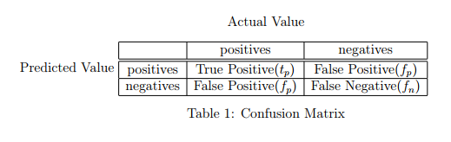




Results and Graphical Analysis

Slide 17
Accuracy
Classifiers Used / Accuracy(%) | Unigram(%) | TF-IDF(%)
Resource Based Classifier | 53.51 | 53.51
Logistic Regression | 78.98 | 85.24
Stochastic Gradient descent | 75.46 | 90.05
Multinomial Naive Bayes | 77.8 | 85.14
Support Vector Machine | 50.4 | 85.14
Decision Tree | 72.08 | 90.85
Voting Classifier | 79.09 | 89.54
Deep Neural Network | 61 | 70.99
Deep Belief Network | 50.5 | 54.33
DecisionTreeClassifier(in case of translation) | 54.5 | 72.5

Slide 19
F-measure
Classifiers Used/F-measure | Unigram | TFidf
Resource Based Classifier | 0.527 | 0.527
Logistic Regression | 0.7853 | 0.9303
Stochastic Gradient descent | 0.7661 | 0.9433
MultiNomial Naive Bayes | 0.7848 | 0.9298
Support Vector Machine | 0.6702 | 0.9278
DecisionTree | 0.72 | 0.9533
Voting Classifier | 0.7628 | 0.9491
Deep Neural Network | 0.583 | 0.678
Deep Belief Network | 0.54 | 0.67
Decision Tree Classifier(in case of translation) | 0.654 | 0.8382

Slide 21
Conclusion
In-language classification approach performs the best among all three.
The TF-IDF method of Feature Matrix Generation gives better results than Unigram Model.
Machine Translation based approach performs better than Resource based approach

Slide 22
Future Work
Resource-based Sentiment Analysis Approach could be extended to include Word Sense Disambiguation and lexical chaining approach to get better results.
Hindi SentiWordNet (H-SWN) currently contains limited words. Improving dictionary can give much better predictions.
Present models implemented do not support negation rules.

Slide 23
THANK YOU

